Slide 1











Slide 2








Agenda
What Open Source really means
A bit of history
The Open Source Way
Copyrights and licenses
Pros and cons of open-source projects
Study: impact of open-source software and hardware on EU economy
Why open-source hardware is important to us in Egypt
Hardware hacking
Methods and examples of hardware hacking
Examples of OSHW products, businesses and communities
OSHW sharing best practices

Slide 3





What Open Source really means
“A product that is made freely available for possible modification and redistribution.”

Slide 4



What Open-Source really means
A product can be
Computer program
Machine
Drink
Image
Electronic circuit
This presentation
Song
Article

Slide 5



What Open-Source really means
Freely available means
The information about the product is accessible. It does not necessarily mean that the product itself is free.

Slide 6
What Open-Source really means
Source means
Code
Assembly instructions
Recipe
Bill of material
Schematic and layout
Documentation

Slide 7
What Open-Source really means
Purposes
Modify to specific need
Add feature
Repurpose
Commercialize
Provide support
Make add-ons

Slide 8























A bit of history
1911
Henry ford vs. ALAM
1950s – 60s
Research labs & academics software
1969
ARPANET
Standalone software industry
1969
IBM antitrust
1973
UNIX v4
1974
US CONTU

Slide 9









A bit of history
Defining Open Source
1983
GNU Project
1985
FSF
1991
Linux kernel
1998
OSI

Slide 10












































A bit of history
Open-Source Hardware
2000
FreeIO
2007
TAPR OHL
2011
CERN OHL
2012
OSHWA

Slide 11























The Open Source Way
theopensourceway.org

Slide 12









The Open Source Way
“Focus on your end users and lower the barriers to participation all around.”

Slide 13



The Open Source Way
“Contributors arise from participants, who all started as users.”

Slide 14






The Open Source Way
“Make your software wildly successful by having a user-centric initiative, while making the community open and welcoming those curious enough to investigate how the software gets created.”

Slide 15



Copyrights and licenses
Copyright is the legal term used to declare and prove who owns the intellectual property
Licensing is the legal term used to describe the terms under which people are allowed to use the copyrighted material

Slide 16





Copyrights and licenses
 | Trade secret | Proprietary | Non-commercial
Description | No information made public | Traditional use of copyright; no rights need be granted | Grants rights for non-commercial use only
Examples for software | Private, internal software | Proprietary software, no public license | JRL, AFPL
Examples for other work | Unpublished | Copyright, no public license | CC BY-NC

Slide 17







Copyrights and licenses
 | Copyleft | Permissive | Public domain
Description | Grants use rights, forbids proprietization | Grants use rights, including rights to relicense | Grants all rights
Examples for software | GPL, AGPL | MIT, Apache, MPL | Unlicense, WTFPL
Examples for other work | CC BY-SA | CC BY | CC0

Slide 18














Pros and cons of open-source projects
Cost
  Not free, but initial cost is significantly lower.
  Maintenance cost can increase exponentially.
Reliability and support
  Have many maintainers and reviewers.
  Depends mainly on community support.

Slide 19














Pros and cons of open-source projects
Lifetime
  Independent of corporate lifetime.
  May fail to gain community interest.
Security
  Vulnerabilities are found faster.
  They also get patched faster.

Slide 20
Pros and cons of open-source projects
Usability
  Open or known standards and conventions.
  Maintainers’ preferences are dominant.

Slide 21

Study: impact of open-source software and hardware on EU economy
“Open-source software contributes between €65 to €95 billion to the EU’s GDP and promises significant growth opportunities for the region’s digital economy.”
openforumeurope.org/open-source-impact-study

Slide 22






Why open-source hardware is important to us in Egypt
Currently
Most startups working on IoT applications, wearable electronics, digital fabrication machines and digitally fabricated products, have based their work on successful or well-known open-hardware projects.
Learning programs in the fields of embedded systems, electronics design, and mechanical design utilize open-source hardware.
Many development boards sold here are cheaper clones of the more expensive original ones. And a few are produced locally.

Slide 23
Why open-source hardware is important to us in Egypt
For the future
Leads to rapid products development
Lowers entry cost
Deepens and builds upon existing knowledge
Helps individuals improve their skills
Shifts the focus to unsolved problems

Slide 24


Hardware hacking
The bad definition of hacking
“Hacking is the misuse of computers, smart devices and or networks to cause damage, corrupt or steal data and documents, for malicious intents or financial gains.”

Slide 25




Hardware hacking
Merriam-Webster definition of hacking
Verb
  To write computer programs for enjoyment.
  To gain access to a computer illegally.
Noun
  An act or instance of gaining or attempting to gain illegal access to a computer or a computer system.
  A clever tip or technique for doing or improving something.
  A creatively improvised solution to a computer hardware or programming problem or limitation.

Slide 26




Hardware hacking
Our definition
“Applying modifications to a product to bypass limitations, add features, enhance capabilities, or to make it serve another purpose.”

Slide 27










Methods and examples of hardware hacking
Patching into I/O
Most electronics have buttons or LEDs.
A button can be used to send control signal to the device.
And LEDs signals can be passed to relays to control other devices.
Maged’s coffee machine hack!

Slide 28
























Methods and examples of hardware hacking
Bus pirating
Requires the use of testing equipment like logic analyzers.
Can be used on internal communication routes and tracks.
Allows you to gain access and pass commands.
OpenWRT and OpenAPS are great examples.

Slide 29











Methods and examples of hardware hacking
Replacing a component
This is also known as circuit bending.
Usually requires great knowledge of the product or by trial and error.
Many mass-produced toys have “modes” that can be changed simply by replacing resistors.
Famous example is changing ROMs in ATARI cartridges.

Slide 30














Methods and examples of hardware hacking
Black magic
Getting the instructions “hex dumping” using JTAG.
Using disassemblers or decompilers to translate the instructions.
Modifying the code then reprogramming.
Gurus play Doom on anything.

Slide 31



















Methods and examples of hardware hacking
Examples around us
Many car accessories sold in Egypt
Some smart-home solutions
Getting power from phone lines
Street sellers looping megaphones
Using optical mouse as encoder
iPhone repairs

Slide 32
























Examples of OSHW products, businesses and communities
Products
Arduino
Raspberry Pi
OpenROV
Solokey
Ultimaker
Prusa
USB armory
and many more..

Slide 33














Examples of OSHW products, businesses and communities
Businesses
Adafruit
Sparkfun
Cosylab
CROETECH
GL-Research
SyncTechnology
Seven Solutions
and many more..

Slide 34












Examples of OSHW products, businesses and communities
Communities
Hackaday
Hackster.io
Instructables
EEVblog
All About Circuits
Dangerous Prototypes
Stack Exchange
and many more..

Slide 35

























OSHW sharing best practices
While designing your product
Use free and open-source software design (CAD) tools where possible.
Use standard and widely-available components, materials, and production processes.
Use an online source-code repository; like GitHub, GitLab, or NotaBug.
All files should be version controlled where possible.
oshwa.org/sharing-best-practices

Slide 36

OSHW sharing best practices
Elements of open-source hardware
Original design files
  2D & 3D CAD files
  Schematic & layout files
  Components libraries
Alternative formats
  Hand-coded G-code
  3D scan output
  Scans of hand-drawn blueprints
Auxiliary design files
  Export or interchange formats
  Fabrication files
Bill of material
Software or firmware
Assembly instructions
Other explanation
oshwa.org/sharing-best-practices

Slide 37







OSHW sharing best practices
Distribution and licensing guidelines
Available documentation
Clear license scope
Include necessary software
Allow derived work
Allow free redistribution
May require attribution
No discrimination against persons, groups, or fields
Free license distribution
Not specific to a product
No restrictions on other products
Must be technology-neutral
oshwa.org/definition

Slide 38
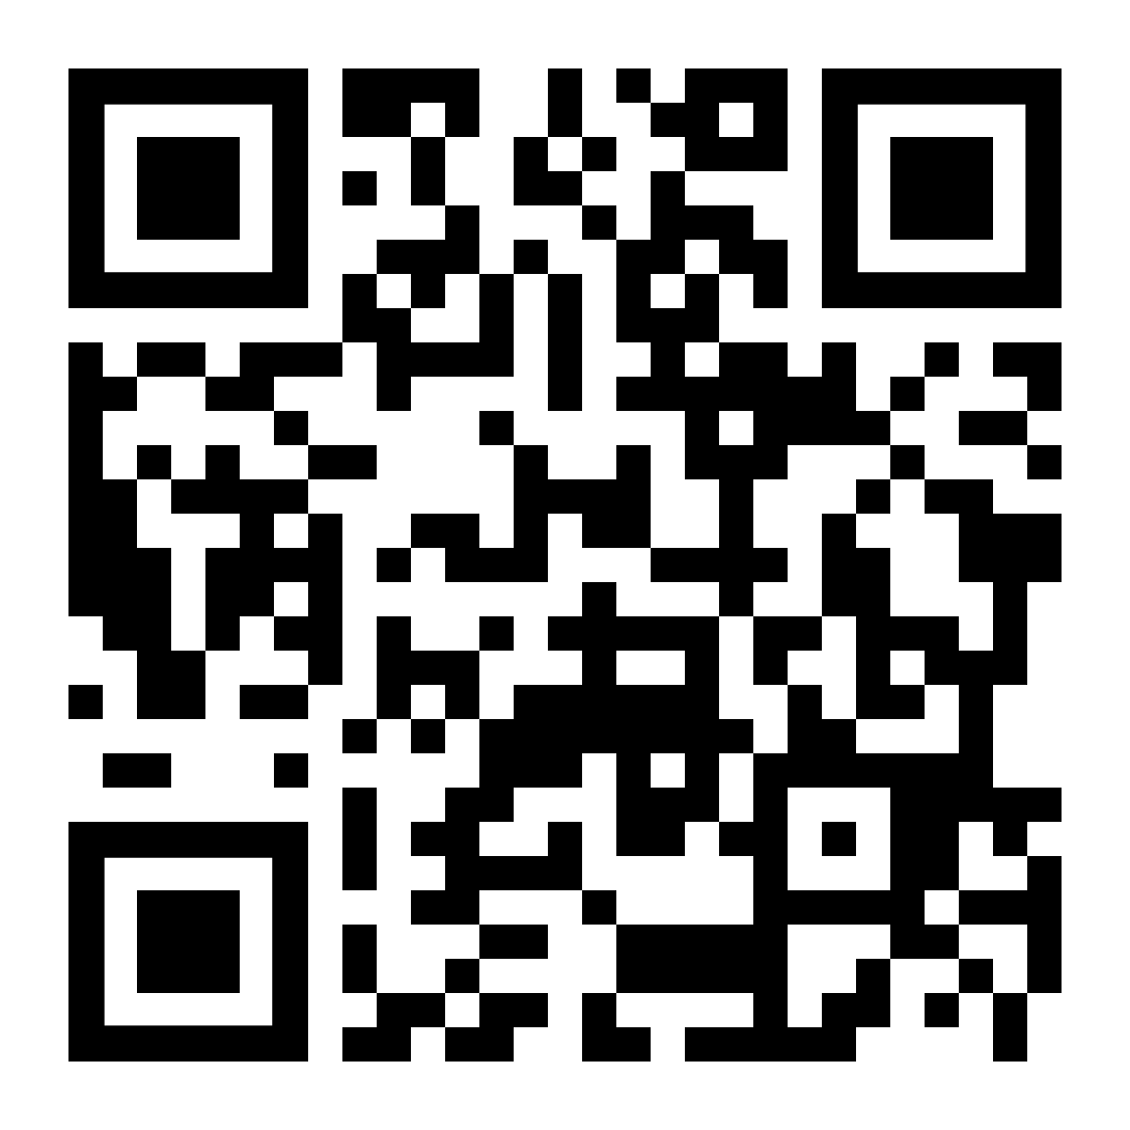







This presentation

